Slide 1
What is Correlated with the US Traffic Accident?
2019 US Accident Visualization
He Qing 19450141
Shi Yi 19451512
Liu Zhaoxing 19456182
Mai Kailun 19456506

Slide 2
Content
1
Background
2
Method
3
Result
4
Conclusion

Slide 3
Background

Slide 4
Background
The major public health problem
According to the WHO Global status, there were 1.3 million people die on the world’s roads and 20 - 50 million are injured every year. Road traffic crashes are a major cause of death among all age groups.
The purpose of our project
To better understand road safety and develop effective road safety interventions, it‘s necessary to know what exactly affects the occurrence of traffic accidents. The purpose of this visualization project is to explore the external factors that affected traffic accidents in the United States in 2019.

Slide 5
Method

Slide 6
Method
Data acquisition
We use the countrywide traffic accident dataset, which covers 49 states of the United States in the year of 2019. This data uses two APIs that provide streaming traffic event data.
Research question
The basic overview of the traffic accidents
Weather factors on traffic accidents
Traffic POI factors on traffic accidents
Visualization method
Tableau: draw a combination of pie chart, box plot, histogram and map to visualize the above questions
Python: data cleaning; draw a violin plot to visualize how weather factors can influence the severity of accident in US

Slide 7
Result

Slide 8
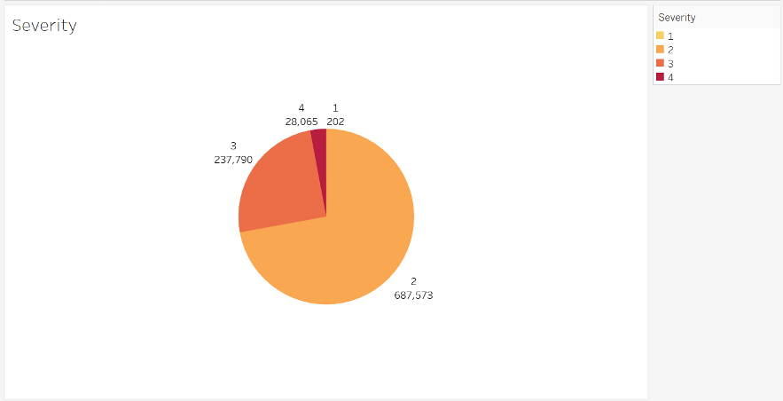
Result
Overview: Severity of car accidents
1. Four severity from 1 to 4
Severity 1 indicates the least impact on traffic and 4 indicates a significant impact on traffic
2. Almost all accidents caused 2-3 level severity of impact on traffic

Slide 9
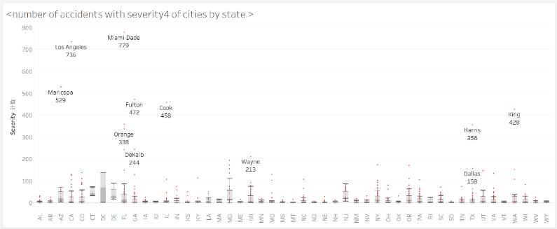
Result
Overview: Severity of car accidents
The numbers of severity-4 traffic accidents in 2019 in most cities are within 100
The figures in several cities in Florida (FL) is far more than 100, and Mai Ami is the city with most severity-4 accidents (779) in the country

Slide 10
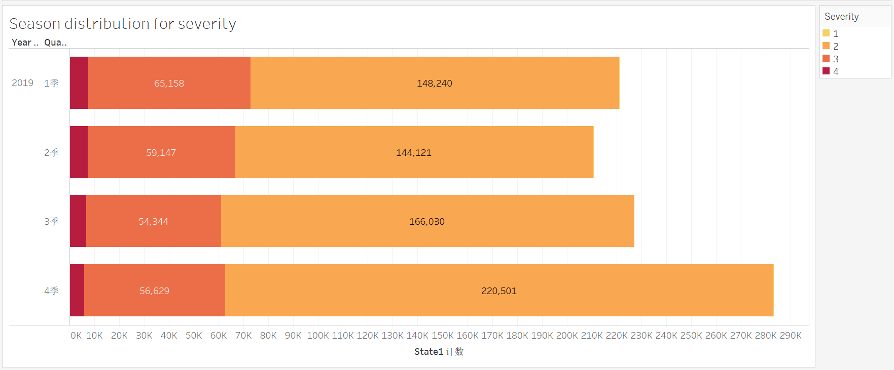
Result
Overview: Season distribution for severity
In the winter there are more traffic accidents, especially for level 2 severity (220,501)
However, more serious accidents occurred more often in the first season

Slide 11
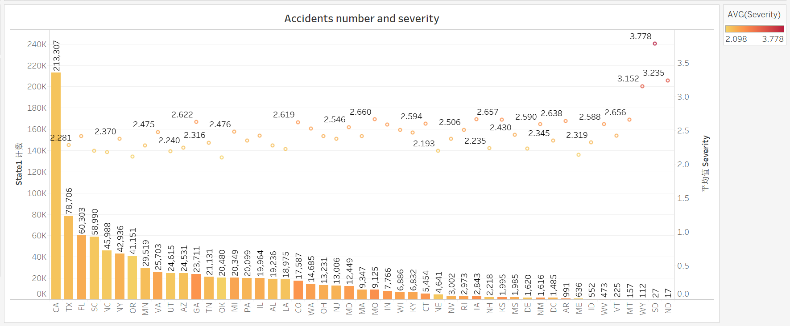
Result
Overview: Geographic distribution for severity
California (CA) has a significantly larger number (231,307) of accidents than other states
The following 6 states also have huge figures, but luckily their severity is not high

Slide 12
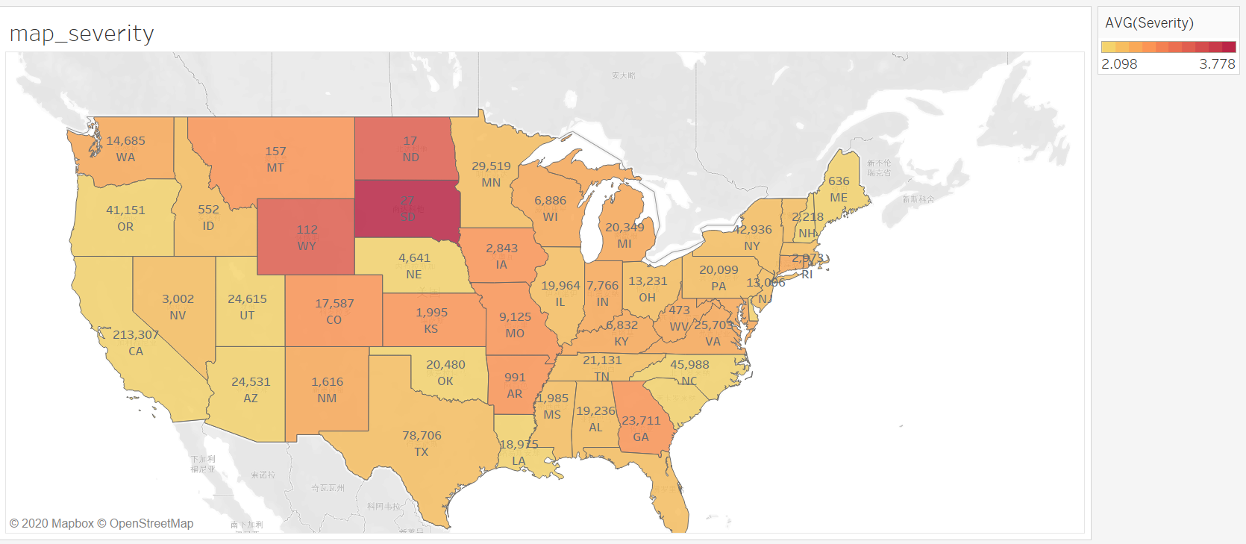
Result
Overview: Geographic distribution for severity
The states with the highest mean of severity yet fewest accidents are in the northern central part of the US
Maybe the geographic situation there is not friendly for developing transportation, so the traffic is small and the capability of recovering traffic is weak

Slide 13
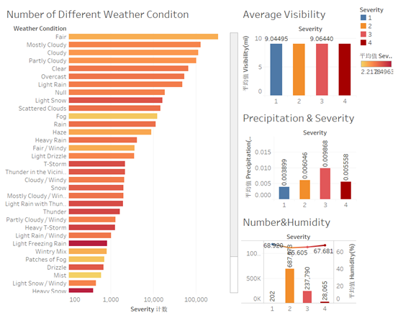
Result
Weather factors on traffic accidents
1. Accidents mostly happened in fair weather
2. Higher average accident severity in critical weather
3. Almost no impact from visibility and humidity
4. Higher precipitation may have high-er severity

Slide 14
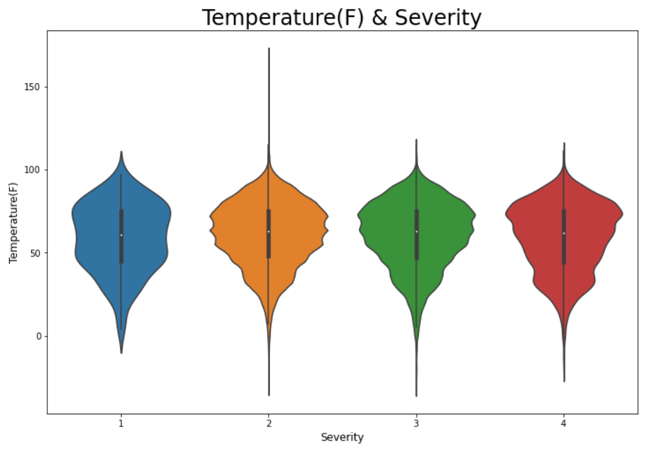
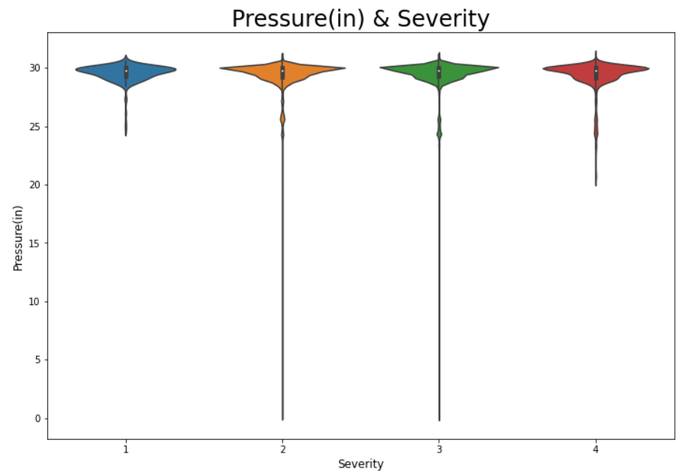
Result
Weather factors on traffic accidents
Distribution of Accidents in different severity

Slide 15
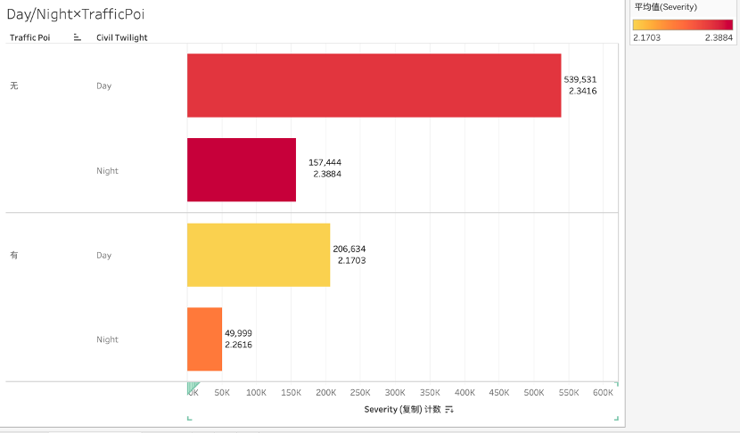
Result
Traffic POI factors on traffic accidents
1. Traffic accidents less happened with POI signs than without it
2. Accidents with POI signs during the day had the lowest severity
3. Road sections without POI signs have a higher average severity of traffic accidents at night, reaching to 2.3884.
4. More accidents during the day than at nights

Slide 16
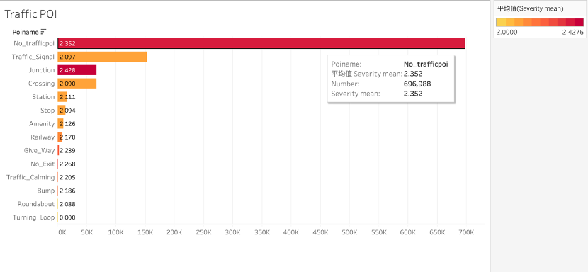
Result
Traffic POI factors on traffic accidents
1. The number of accidents without POI signs in the United States was as high as 696,988
2. The average severity of the accidents was reaching 2.352
3. The nearby Traffic signs on the Top 3 number of accidents were Traffic signal, Junction, and Crossing
4. The most serious accident occurred near the junction, with an average severity of 2.428
5. The presence of a turning loop sign had no effect on the occurrence of a traffic accident

Slide 17
Conclusion

Slide 18
Conclusion
Accidents will not usually be benign with severity at 1
Accidents happen more frequently in the daytime probably as a result of people going out in the daytime
POI can have an obvious correlation to accident severity, as the average severity is lower than those on the road without POI
The wind direction, average visibility and humidity have less correlation with the number and severity of accidents

Slide 19
Conclusion
Precipitation has a strong correlation with the severity of accidents
Governments are supposed to set up more necessary traffic signals or signs on roads
Driving in critical weather conditions needs more concentration
Drivers should pay more attention to nearby traffic signs and bad weather conditions to avoid traffic accidents

Slide 20
Thank you

